Slide 1
IoT Weather station
Rasmus Ølholm Nielsen Karsten Winther Johansen

Slide 2

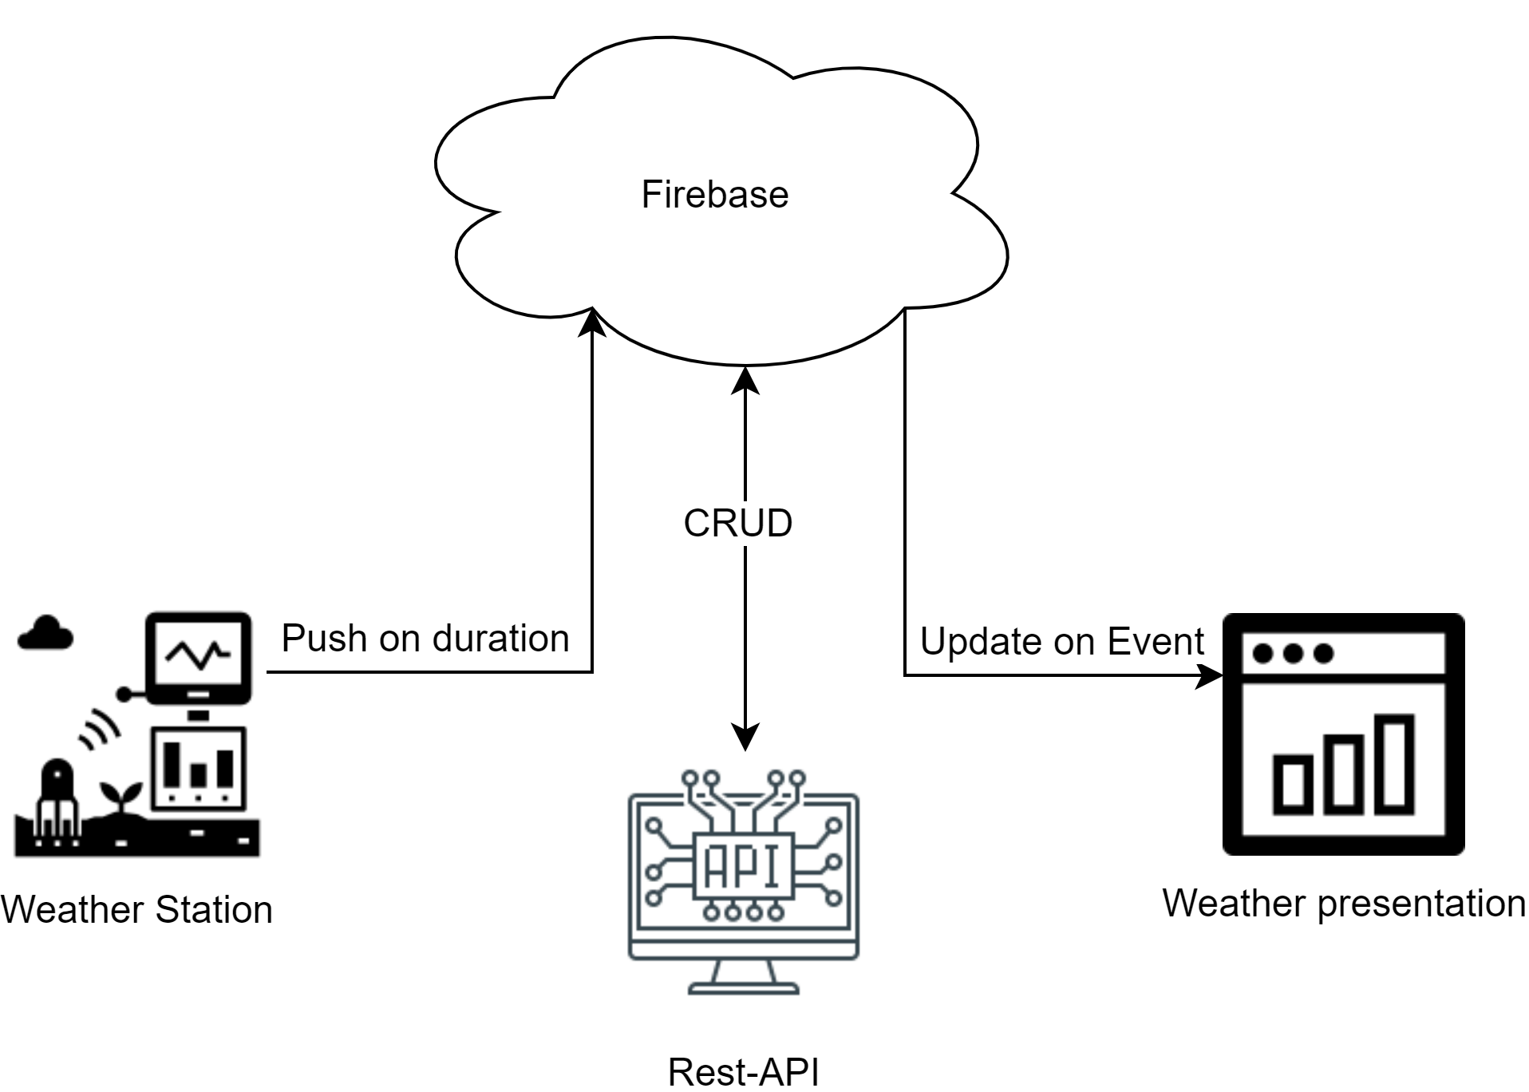
Basics
Build an internet-connected weather station
RPI will be used as weather station
Data should be provided via web of things
Reporting should happen using MoM such as mqtt or rest

Slide 3
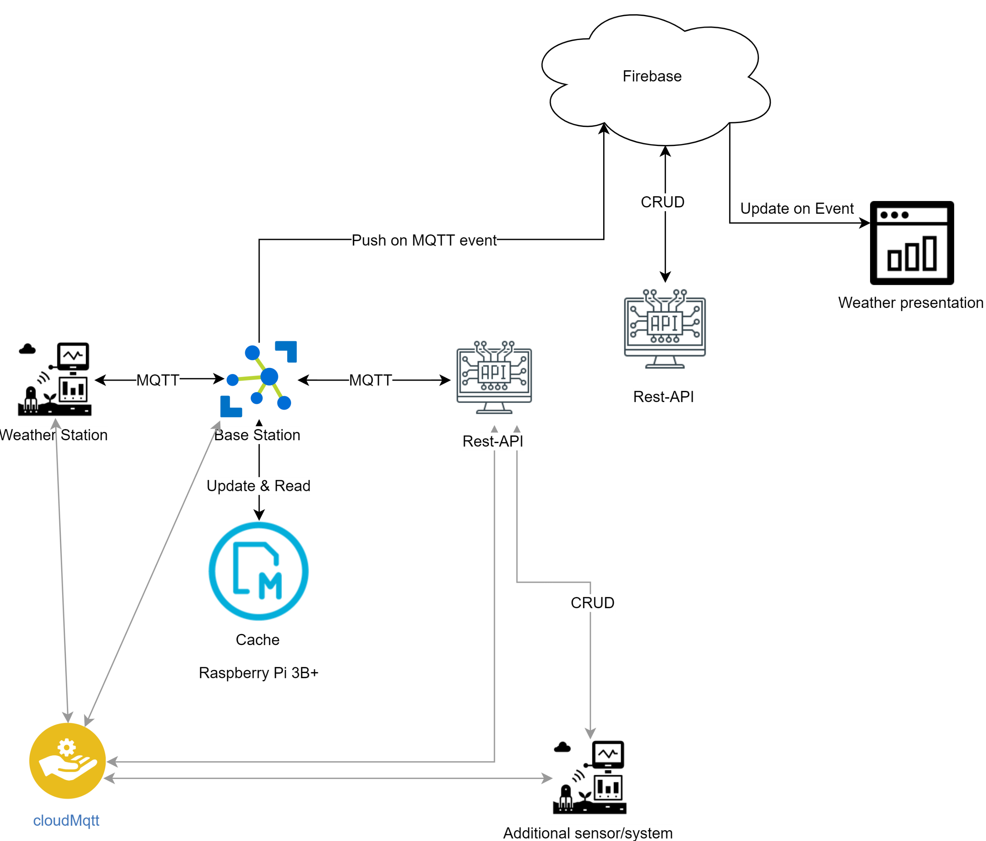
Experimental exploration expansion
Separation of concerns
Mqtt as inter device Communication
Cache recent data
Rest-api to weather station interaction through mqtt
Possibility of extension

Slide 4
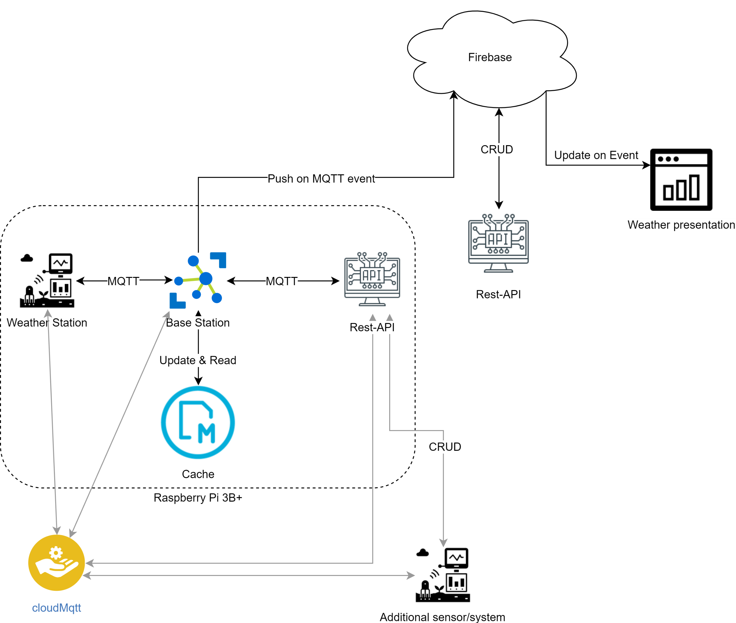
Description of expansion
Three python applications
Weatherstation
Base station
Rest-aPI
Running on same platform
Communication interfaces

Slide 5

Description of separation
Deployment to different platforms

Slide 6
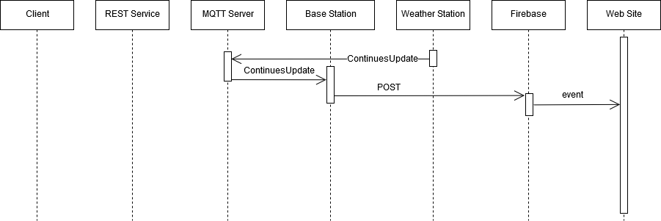
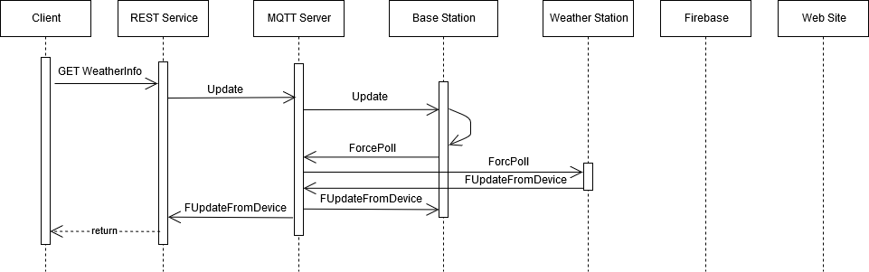
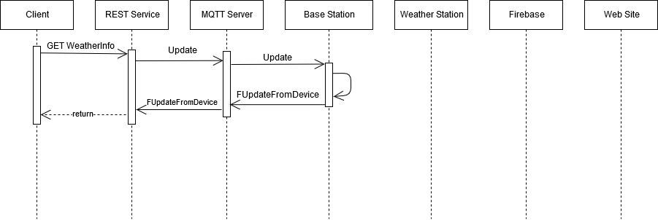
Sequences in the system

Slide 7
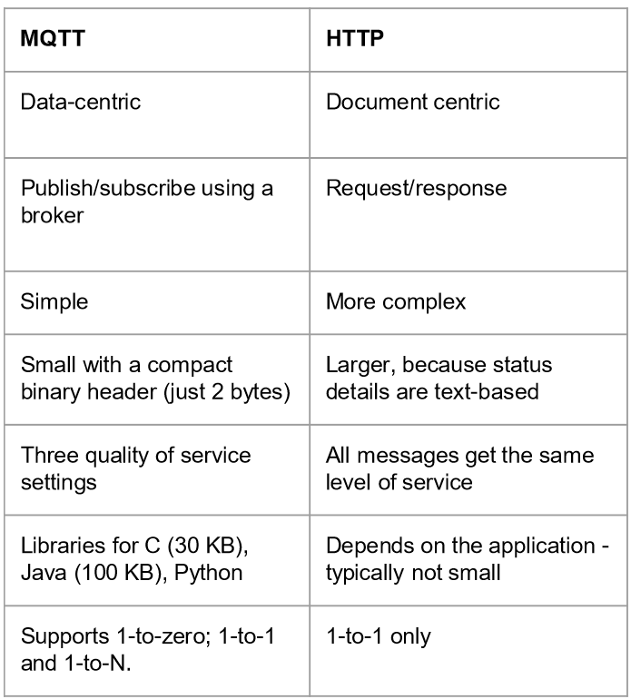
Motivation of choosing MQTT

Slide 8
Findings done in the explorative implementation
MQTT less overhead
MQTT offers encrypted connection
MQTT is suitable for communicating sensor data
MQTT 1:N communication
MQTT enables other devices to interact with system
REST to Device using mqtt enables other devices to interact with system
Separation of concerns is possible
Notes:
MQTT encryption
TLS/SSL overhead
Session resumption
Not able to sleep due to long term connections
Computational overhead from cipher calculations

Slide 9
DEMO

Slide 10
Questions?

